Slide 1
Carbon Cycle

Slide 2
8.3.3 Carbon Cycle
I can identify and describe the carbon cycle including the connections between photosynthesis and respiration.
I can make connections between ecosystem changes and the stability of cycling matter between living and nonliving parts of an ecosystem.
I can describe and evaluate how changes in an ecosystem affect the flow of energy through the carbon cycle.

Slide 3
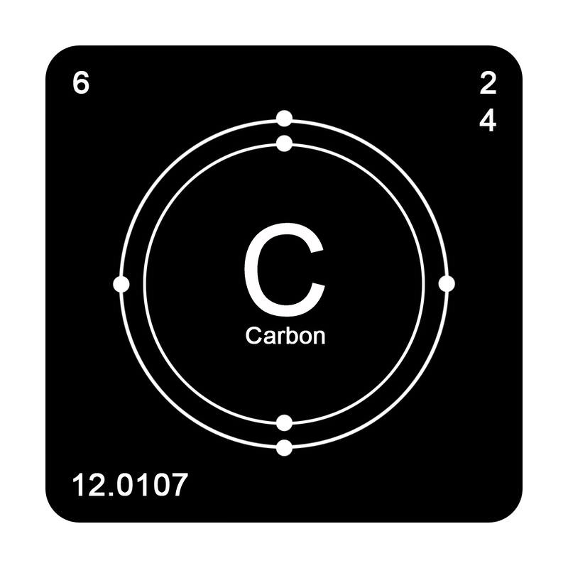
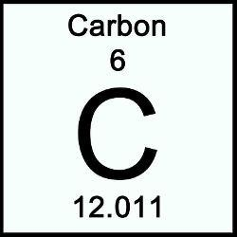
8.3.3 Carbon Cycle
What is Carbon?
An atom with six protons, six neutrons, and six electrons.
Because it has a four electrons available for covalent bonds; it is the primary compound for all living and once living things.

Slide 4
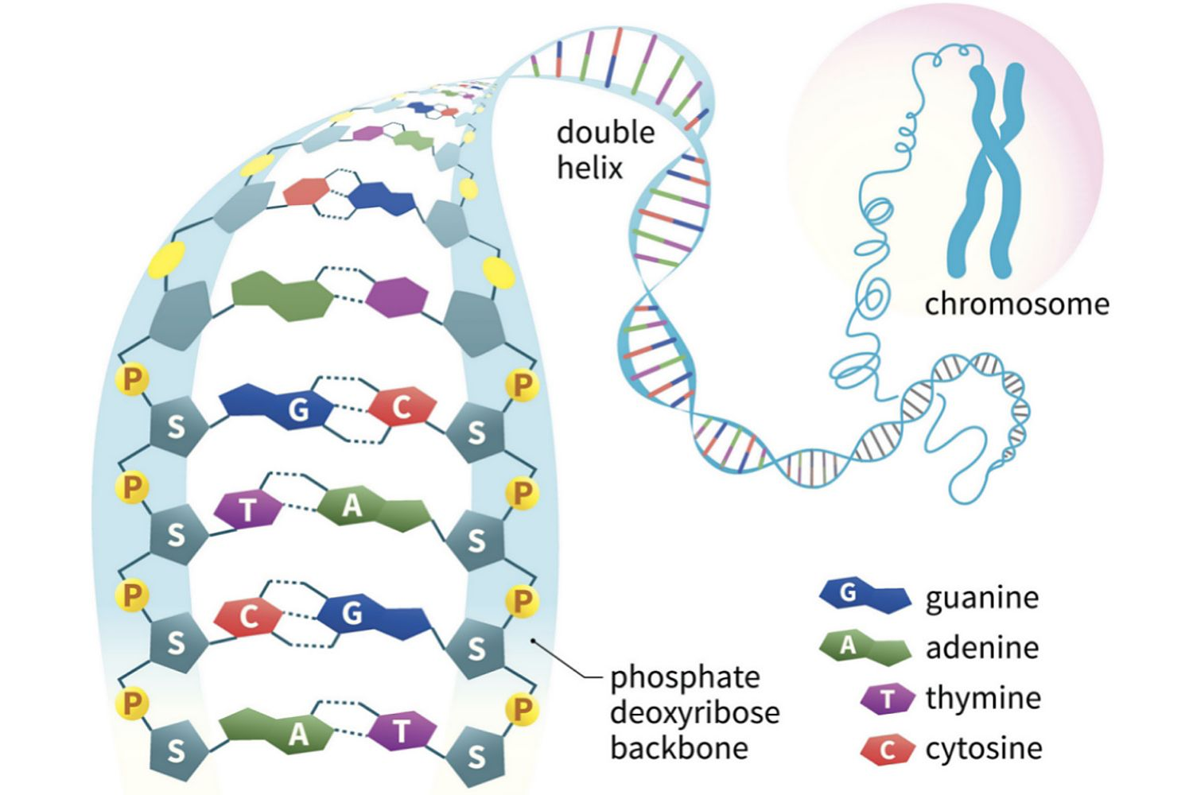
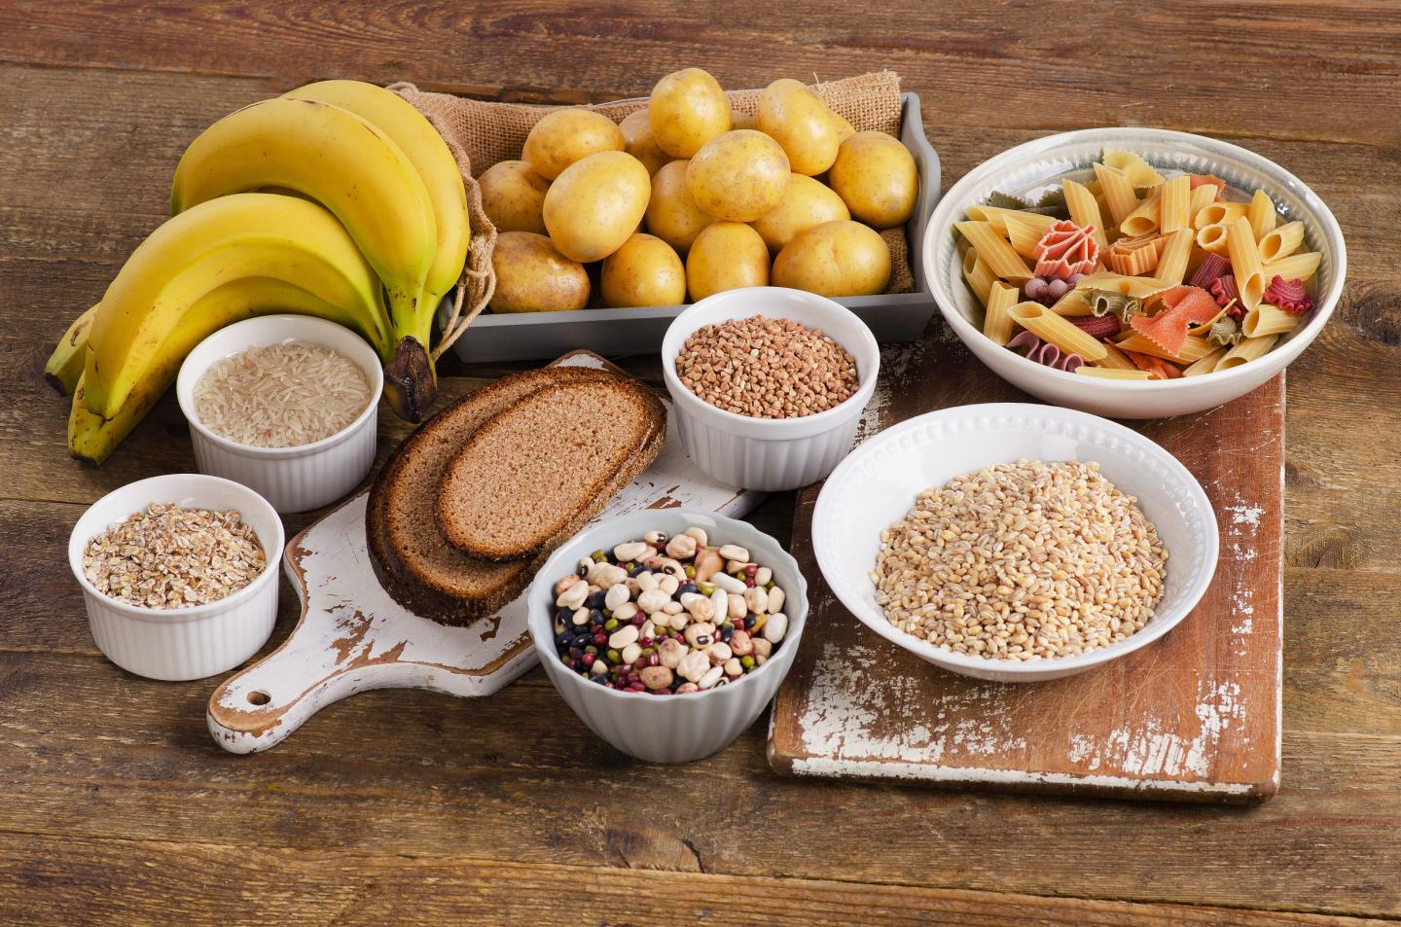
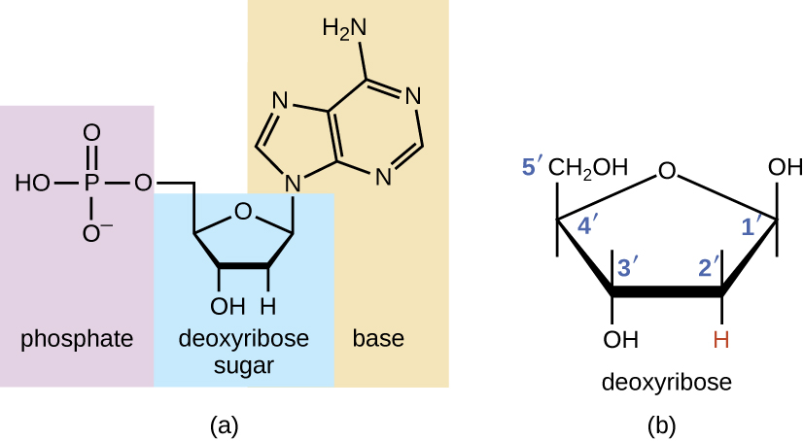
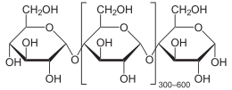
Carbon can be found in…
DNA
STARCH

Slide 5
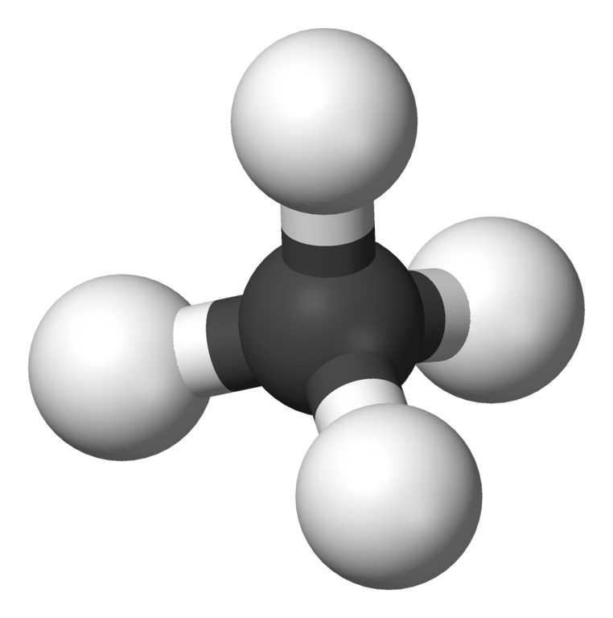
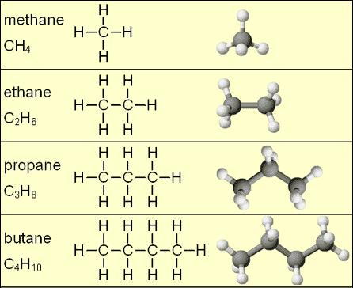
Carbon can be found in…
HYDROCARBONS

Slide 6
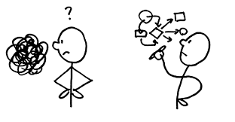
8.3.3 Carbon Cycle
Do organisms make their own carbon?
No! Carbon is recycled.
But where does this carbon come from and how is it recycled through the ecosystem?

Slide 7
8.3.3 Carbon Cycle
The carbon cycle is an exchange of carbon as it cycles through different living and non living materials.
Carbon can be found in the
Atmosphere (air)
Geosphere (rock/soil)
Hydrosphere (water/ocean)
Biosphere (living organisms)

Slide 8
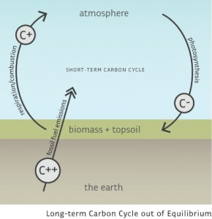
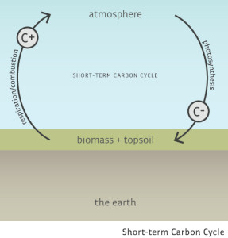
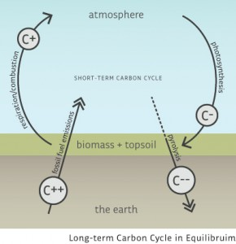
Carbon Cycle Equilibrium
Burning fossil fuels and adding carbon to the carbon cycle
Photosynthesis &
cell respiration
In natural cycles
Natural processes keep pace with addition of new carbon

Slide 9
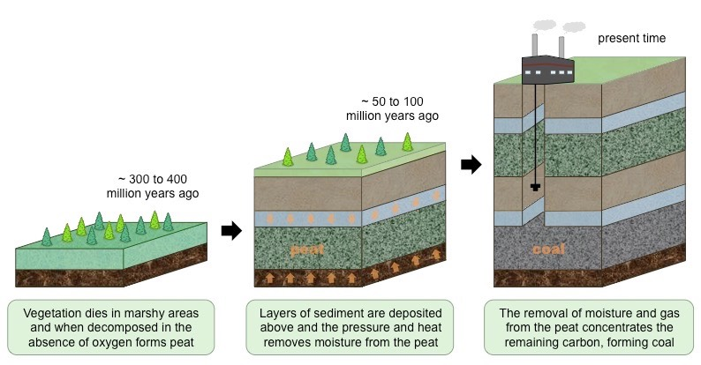
Geosphere
Coal Formation

Slide 10
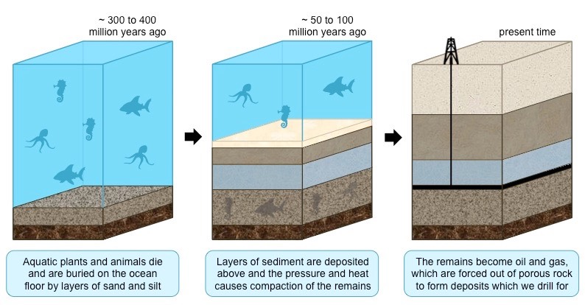
Geosphere
Oil and Natural Gas Formation

Slide 11
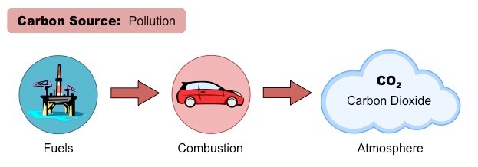
Fossil Fuels and Pollution

Slide 12
Fossil Fuels and Pollution
When organic compounds rich in hydrocarbons are heated in the presence of oxygen, they undergo a combustion reaction releasing carbon dioxide into the air.
An excess of carbon dioxide can change the balance of carbon cycle and can create changes to the ecosystem.

Slide 13
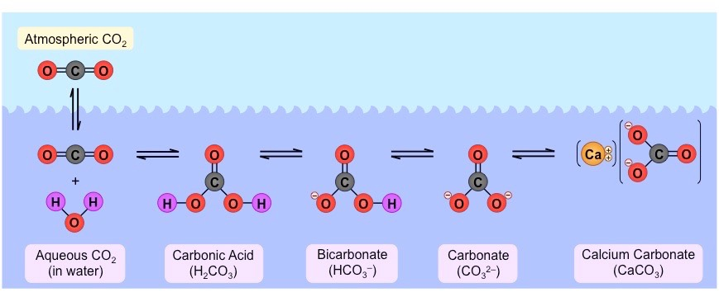
Hydrosphere
Calcium Carbonate
Formation

Slide 14
Hydrosphere
The ocean is the largest active carbon sink
on Earth.
Some CO₂ may remain as dissolved gas within the water, however the majority will combine with water to form carbonic acid.
The solubility of CO₂ gas occurs in colder ocean water.

Slide 15
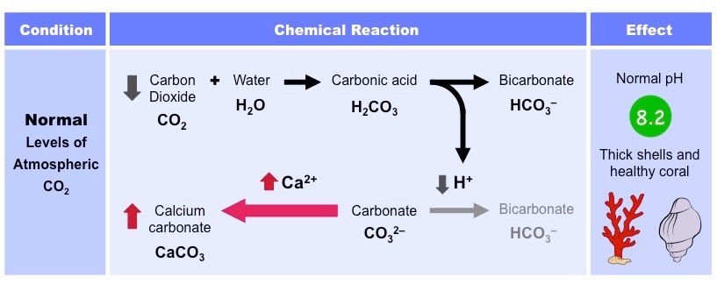
Hydrosphere

Slide 16
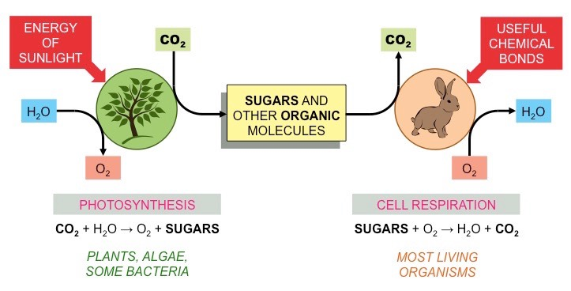
Biosphere

Slide 17
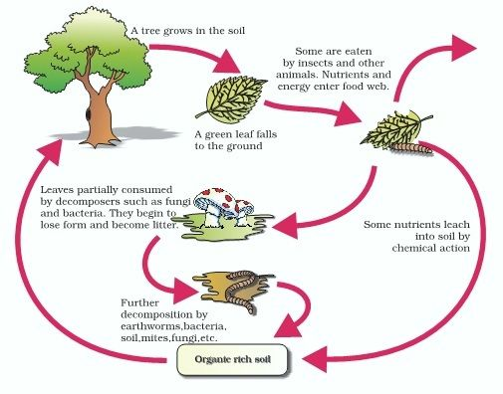
Biosphere

Slide 18
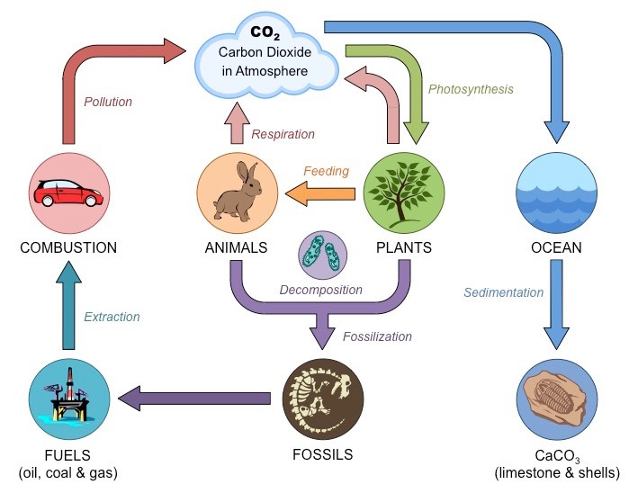

Slide 25
8.3.3 Carbon Cycle

