Slide 1
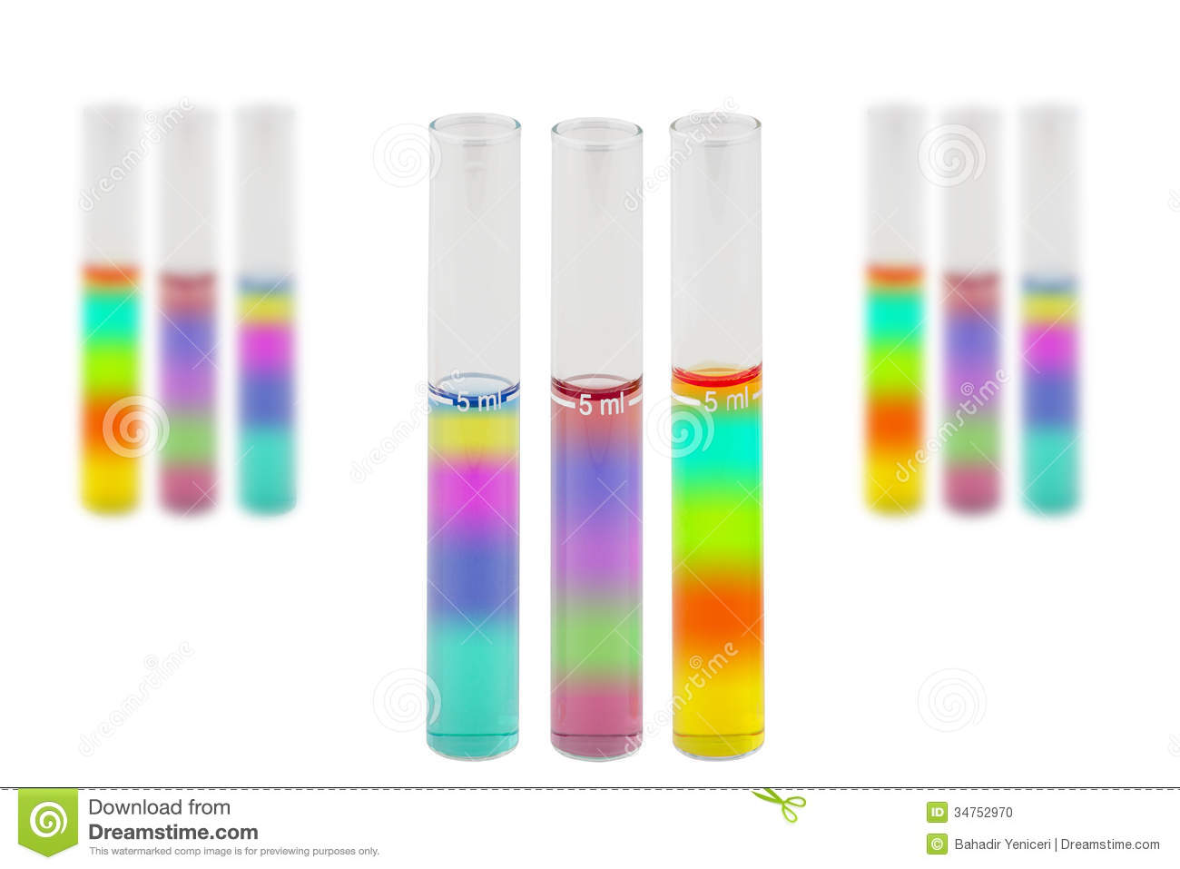
DENSITY

Slide 2
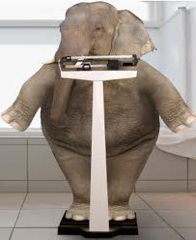
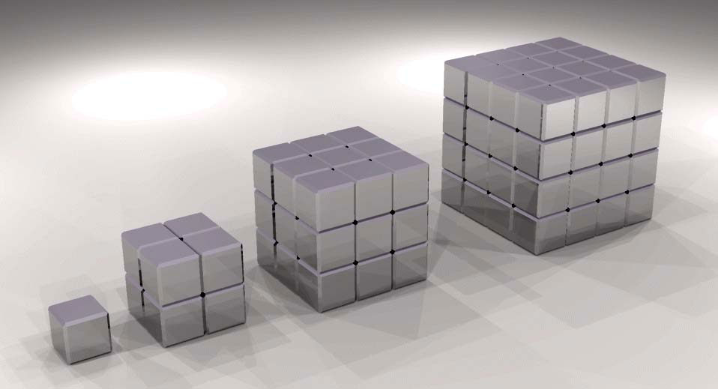
MASS & VOLUME
All matter has mass & volume
Mass is the amount of matter that an object contains
Volume is the amount of space something occupies

Slide 3
Density
Density is the measurement of how much matter is packed into a given volume.
The mass of atoms, their size, and how they are arranged determines the density of the substance.

Slide 4
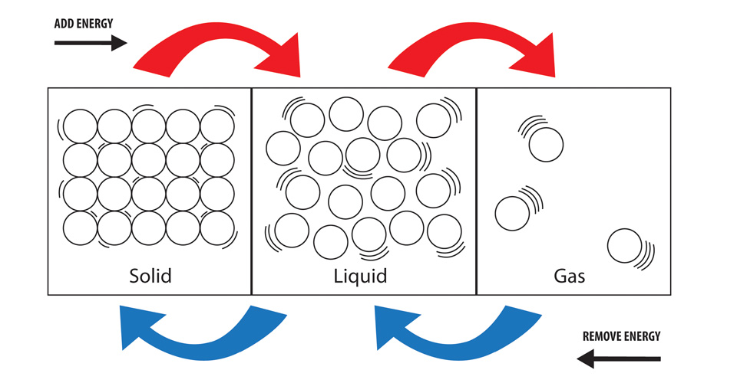
Density Of Matter
WHICH STATE OF MATTER WOULD BE THE MOST DENSE?

Slide 5
NO MATTER HOW BIG OR HOW SMALL
When a piece of matter is broken off or compressed together, the ratio of mass and volume stays the same.
The density of the matter remains the same no matter how big or how small the sample.

Slide 6
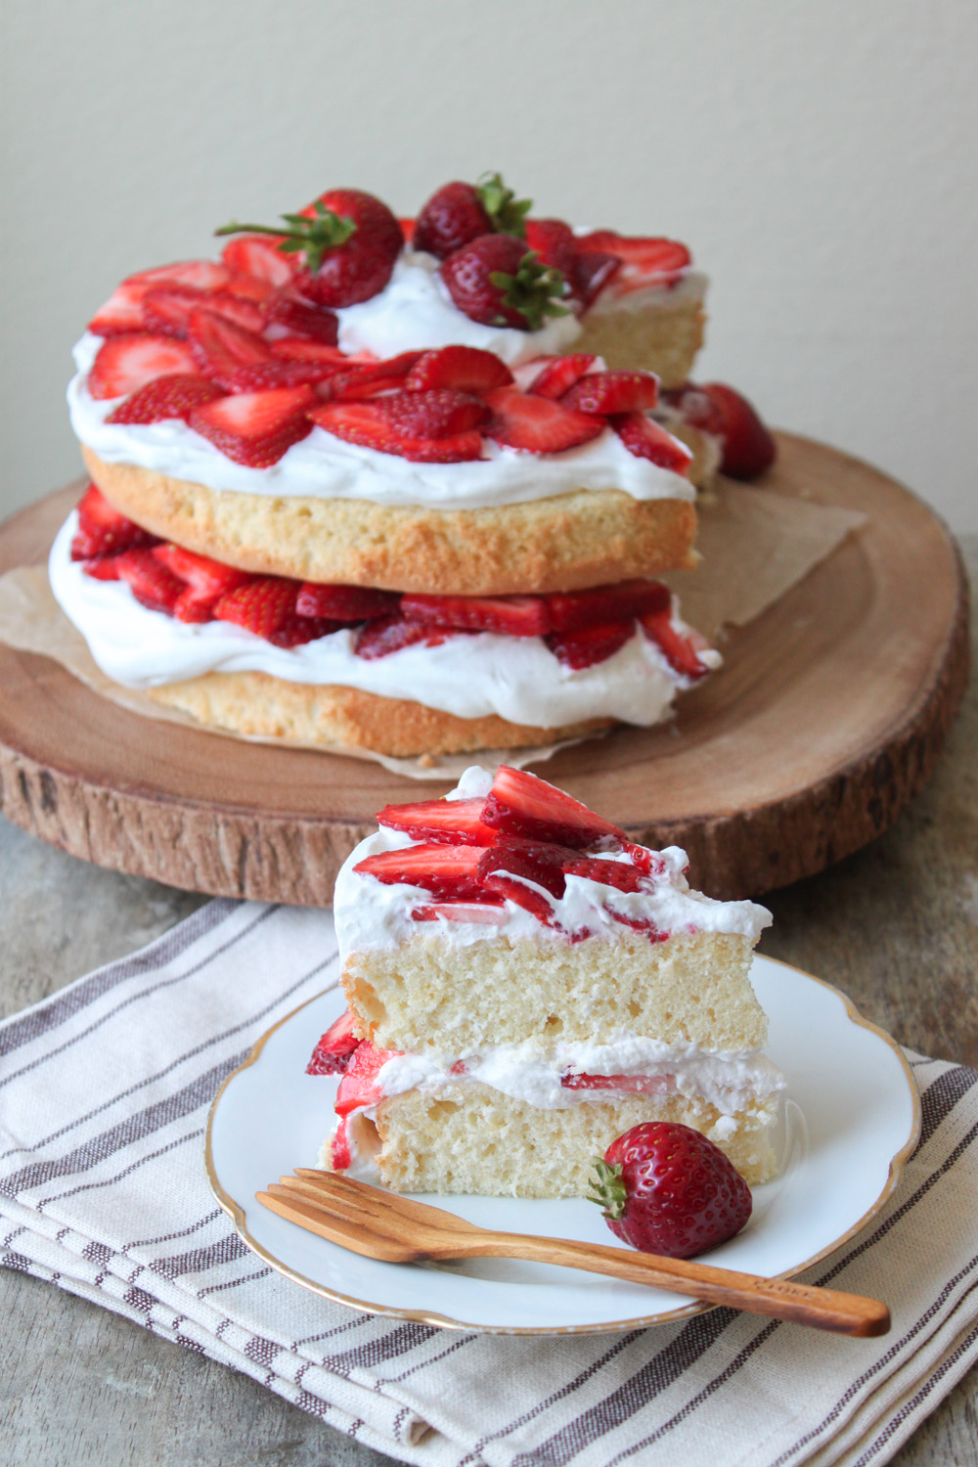
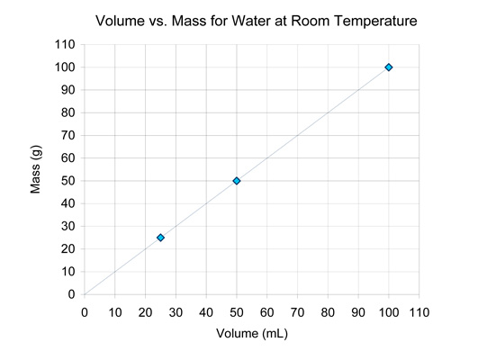
Density & Size
A piece of cake is as dense as the entire cake
Water is the same density no matter how much water is in the sample

Slide 7
Calculating for Density
Calculate for density if
the mass and volume is known
Mass M Density = Volume = V
Unit of measure • solids = g/m³ or g/cm³ • liquids = g/l or g/ml

Slide 8
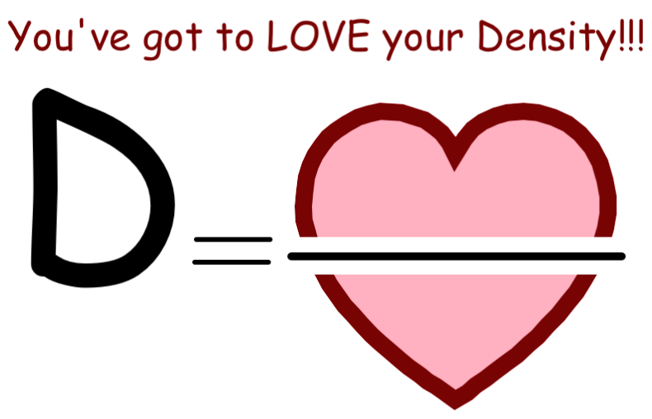
Density is LOVE!!!

Slide 9
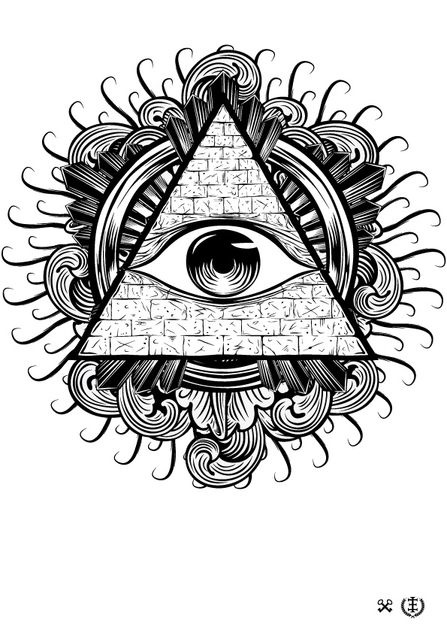
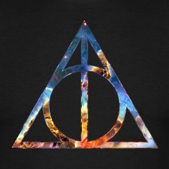
MAGIC TRIANGLE

Slide 10
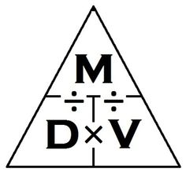
Density Triangle

Slide 11
Density Triangle

Slide 12
Density Triangle

Slide 13
Density Triangle

Slide 14
Density Triangle
Use this triangle to help you!
If you need to find the MASS, cover up the M
Mass = Density x Volume
If you need to find the VOLUME, cover up the V
Volume = Mass ÷ Density
This also works for finding DENSITY! Cover up the D
Density = Mass ÷ Volume

Slide 15
Let’s try a few problems…
Calculate the density of an object that has a mass of 24 grams and a volume of 127mL.
0.189 g/mL
Calculate the density of an object that has a mass of 54 kg and a volume of 32 Liters.
1.688 kg/L
Calculate the density of an object that has a mass of 10 g and a volume of 5 mL.
2 g/mL

Slide 16
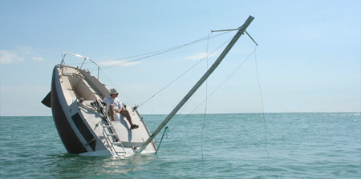
Sink or Float
Water has a density of 1g/ml
Any solid with a density
greater than 1g/cm³ will sink
less than 1g/cm³ will float.

Slide 17
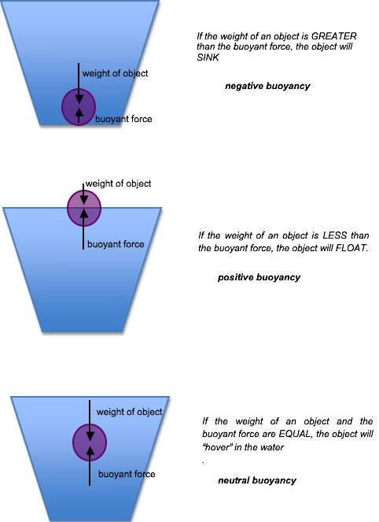
More dense than water
Less dense than water
Equal density to water

