Slide 1
Natural Resources
And Geology

Slide 2
Natural resource
Natural resources are raw materials from the Earth that can be grown, mined, extracted, or collected.
Natural resources are not man made.
Natural resource examples:
Air Water Soil Plants
Animals Petroleum/Oil Natural Gas
Minerals

Slide 3
Where did it all come from?
Natural resources that come from organic materials are considered biotic resources.
Biotic resources examples are plants, animals, and fossil fuels.
Fossil fuels; such as coal, natural gas, and oil are classified as biotic resources because they formed from the decay of organic matter over millions of year.

Slide 4
Fossil fuels
Coal formed from carbon rich plants to form peat. Which then fossilizes into the layers of the Earth.
Oil and natural gas formed from ancient ocean plants and small organisms that became fossilized and compressed in layers of sediment.

Slide 5
Where did it all come from?
Abiotic resources come from inorganic materials.
Air, sunlight, and water are abiotic resources.
Minerals make up rocks and ore such as gold, copper, and iron which are considered abiotic.

Slide 6
Rock cycle

Slide 7
Uneven distribution
Some areas of the Earth have access to many varied resources while others have few or none.
The distribution of many natural resources depends on the geological history and the geological processes the land has been through.

Slide 8
Geological Processes
Natural resources are unevenly distributed due to geological processes:
Tectonic plates
Volcanic activity
Changing ocean levels
Formation of rocks and minerals
Water Cycles
Climate/Weather
Ancient plant and animal life in a region

Slide 9
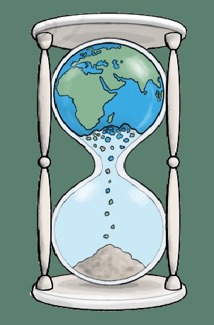
Geological History
The geological processes occur and compound over time creating new materials and natural resources.
Plants and animals can develop and repopulate in a short period of time.
Many of these processes take
hundreds of millions of years
to produce natural resources.

Slide 10
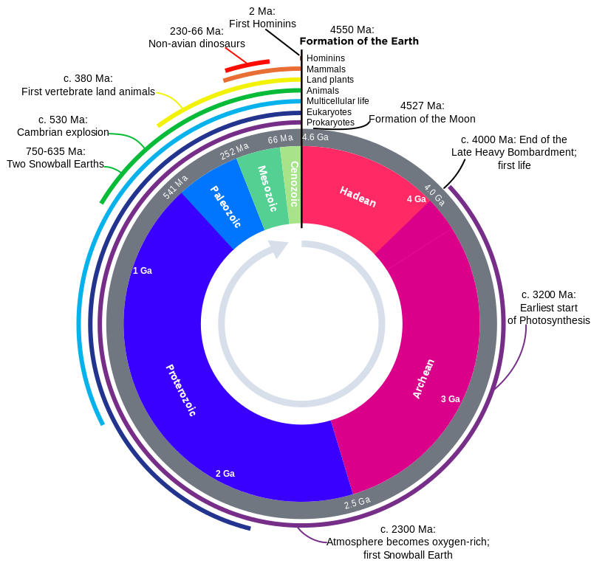
Geological History
The geological history of Earth follows the major events in Earth's past based on the geologic time scale, a system of chronological measurement based on the study of the planet's rock layers

Slide 11
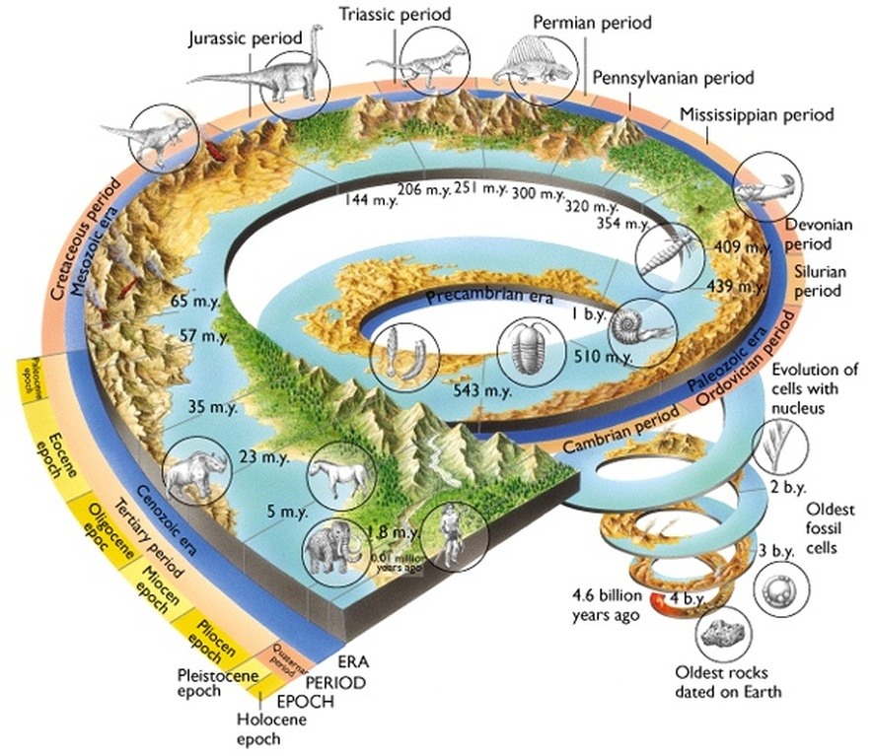
Geological history

Slide 12
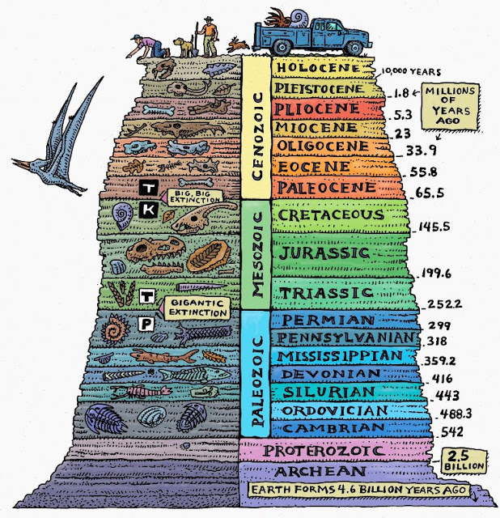
Geological history

Slide 13
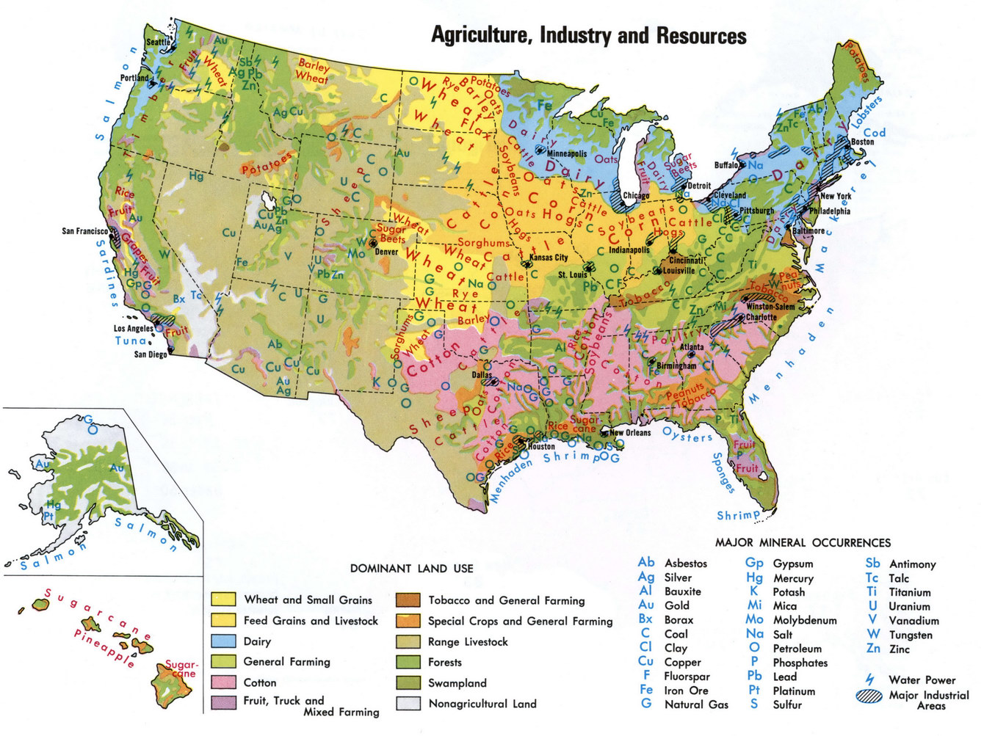

Slide 14
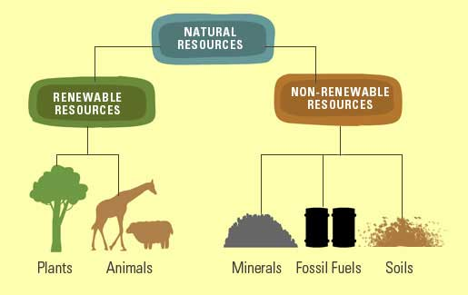
Renewable & non-Renewable

Slide 15
Problems associated with natural resources
Too little natural resources:
In many regions of the world have limited resources, overpopulation in the region, and environmental degradation.
This has lead to extreme poverty and income inequality. Resulting in rebellions and war situations in society.

Slide 16
Problems associated with natural resources
Too much natural resources:
In regions with excess natural resources leading to cooperate and government greed, corruption, and conflict.
Conflict does not occur solely
in local communities. Outside
nations have extreme interest
in the wealth of natural resource
rich countries. This often leads to
tensions between countries,
and can foster or engage conflicts.

Slide 17
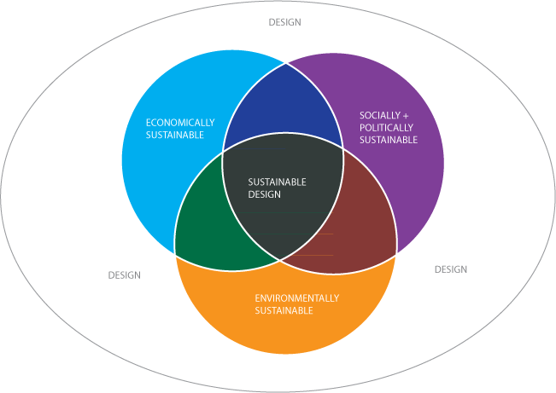
Problems associated with natural resources
When discussing natural resources:
Environmental Impact
Social/Political
Economical

