Slide 1
Natural & Synthetic Polymers

Slide 2
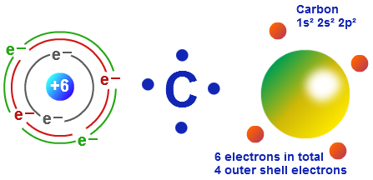

Slide 3
Monomer: Atoms bonded together to make a single molecule
Polymer: long molecule consisting of many similar or identical building blocks linked by covalent bonds.
Polymerization is the bonding of monomers.

Slide 4
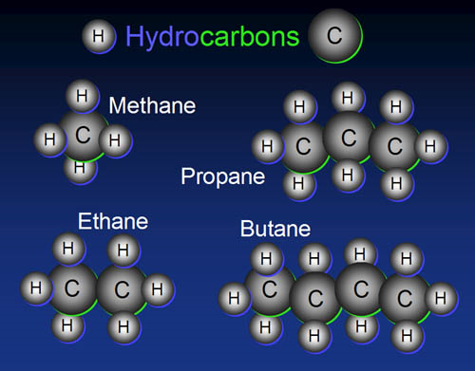
Hydrocarbons ex: Alkanes
1 – Meth-
2 – Eth-
3 – Prop-
4 – But-
5 – Pent-
6 – Hex-
7 – Hept-
8 – Oct-
9 – Non-
10 – Dec-
11 – Undec-
12 – Dodec-

Slide 5
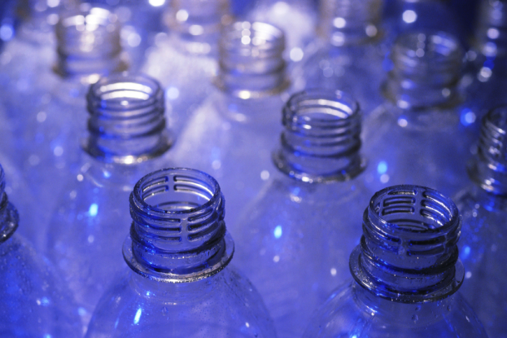
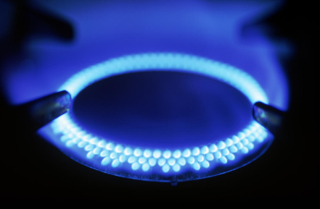
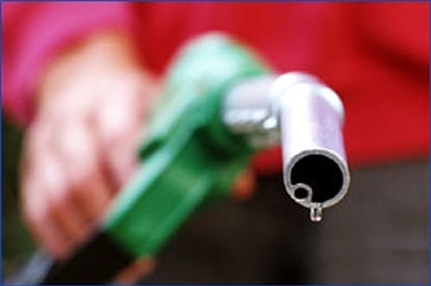
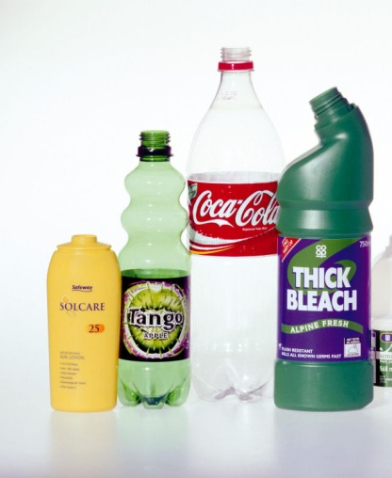
Hydrocarbons at Room Temperature
Gas
Methane
Ethane
Propane
Butane
Liquid
Waxy
Plastic
20 to 40 Carbons
40 or more Carbons
5 to 19 Carbons

Slide 6
Melting Point
As the length of hydrocarbons get longer, the Melting Point grows Higher… why?

Slide 7
Natural Polymers
Natural polymers come from material that are gathered from the Earth. They can be found from material that can be grown, mined or pumped from the Earth.

Slide 8
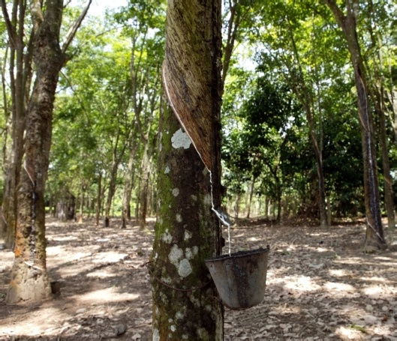
Rubber Tree
Sap:
Sticky
Viscous
Gooey
Goodyear
Experiment
Luck
Profit

Slide 9
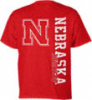
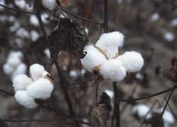
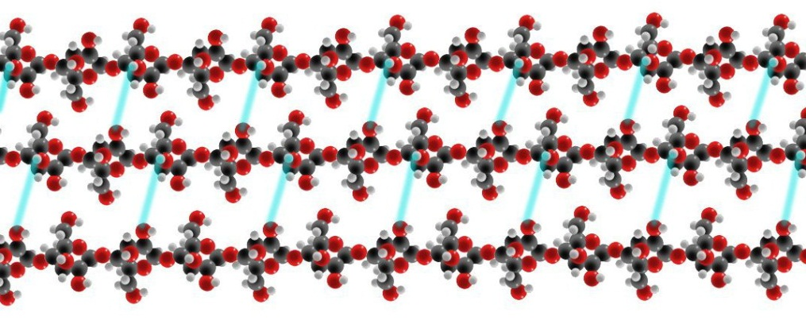
Cotton
Long Strands of Cellulose
+ Hydrogen Bonds
Cellulose is the most common organic material on earth!
It is also a primary constituent of wood and paper.

Slide 10
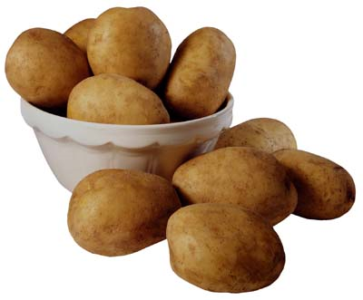
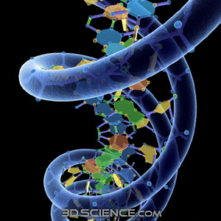
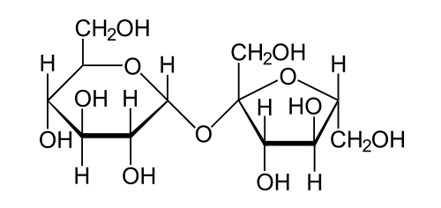
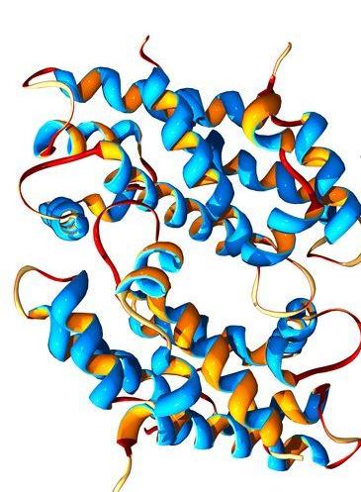
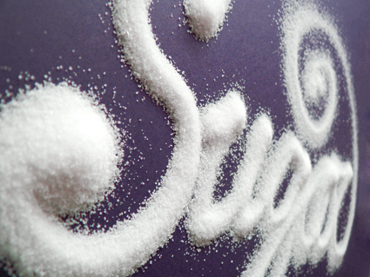
Polymers in Biology
Starch
DNA
Sugar
Proteins

Slide 11
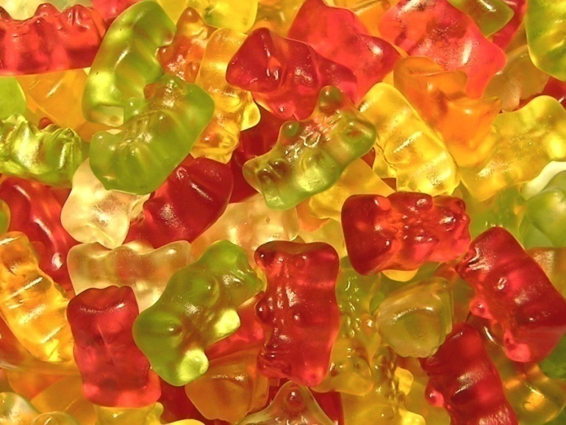
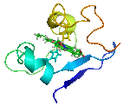
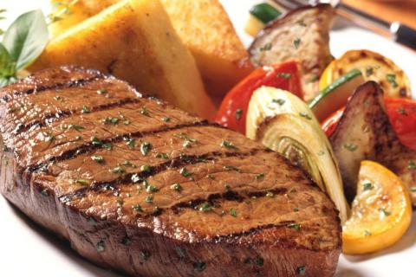
Some Natural Polymers in Food…
Gelatin in gummi worms and gummi bears are made from natural polymers!
Bubble gum contains styrene butadiene rubber!
Carbohydrates (starches) and proteins are examples of natural polymers!
natural polymers

Slide 12
Synthetic Polymer
Made from natural resources that are changed chemically to produce a new substance with different bonds and properties.

Slide 13
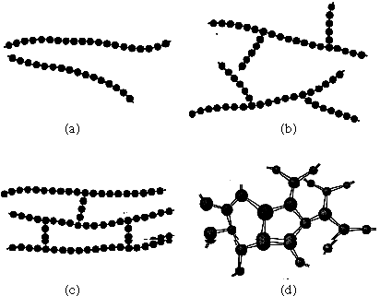
Molecular Structure of Polymers
Linear
High Density Polyethylene (HDPE), PVC, Nylon, Cotton
Branched
Low Density
Polyethylene (LDPE)
Cross-linked
Rubber
Network
Kevlar, Epoxy

Slide 14
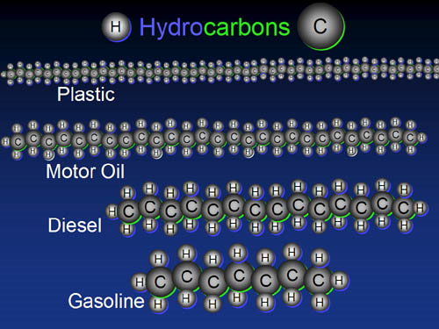
What other material properties change?
Viscosity
Hardness
Toughness
Flammability

Slide 15
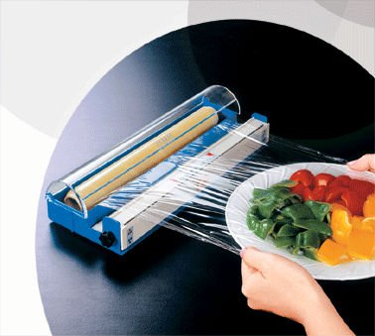
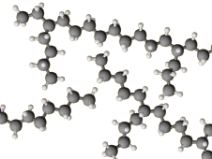
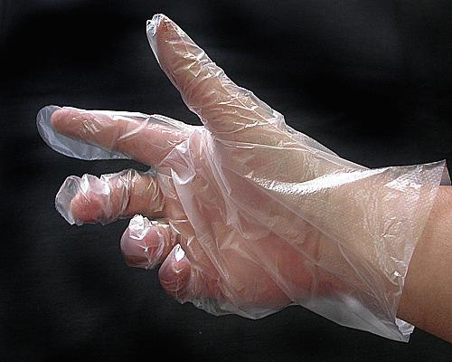
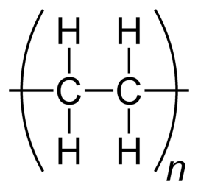
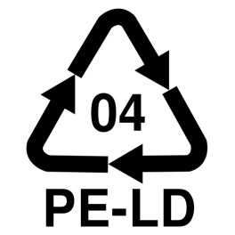
Low-Density Polyethylene (LDPE)
Chain Length: 1000 - 2000

Slide 16
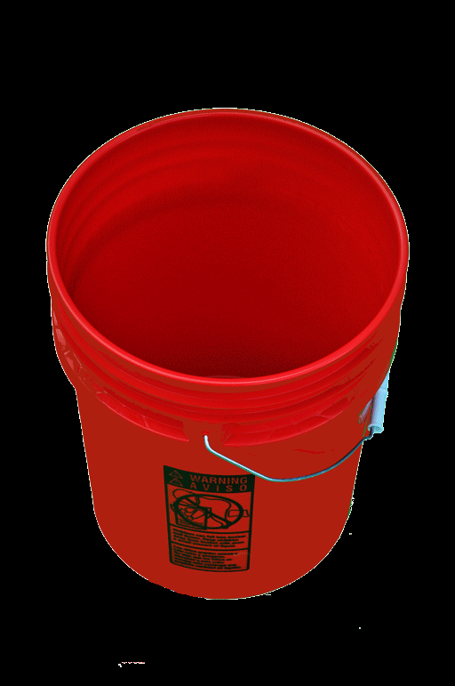
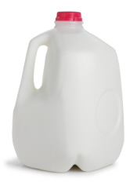
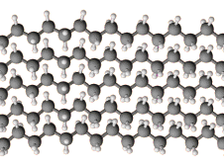
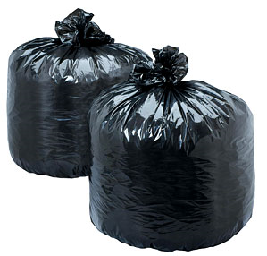
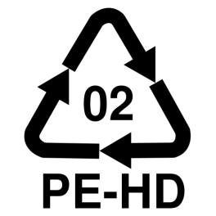
High-Density Polyethylene (HDPE)
Chain Length: 10,000 – 100,000

Slide 17
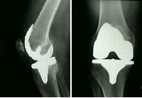
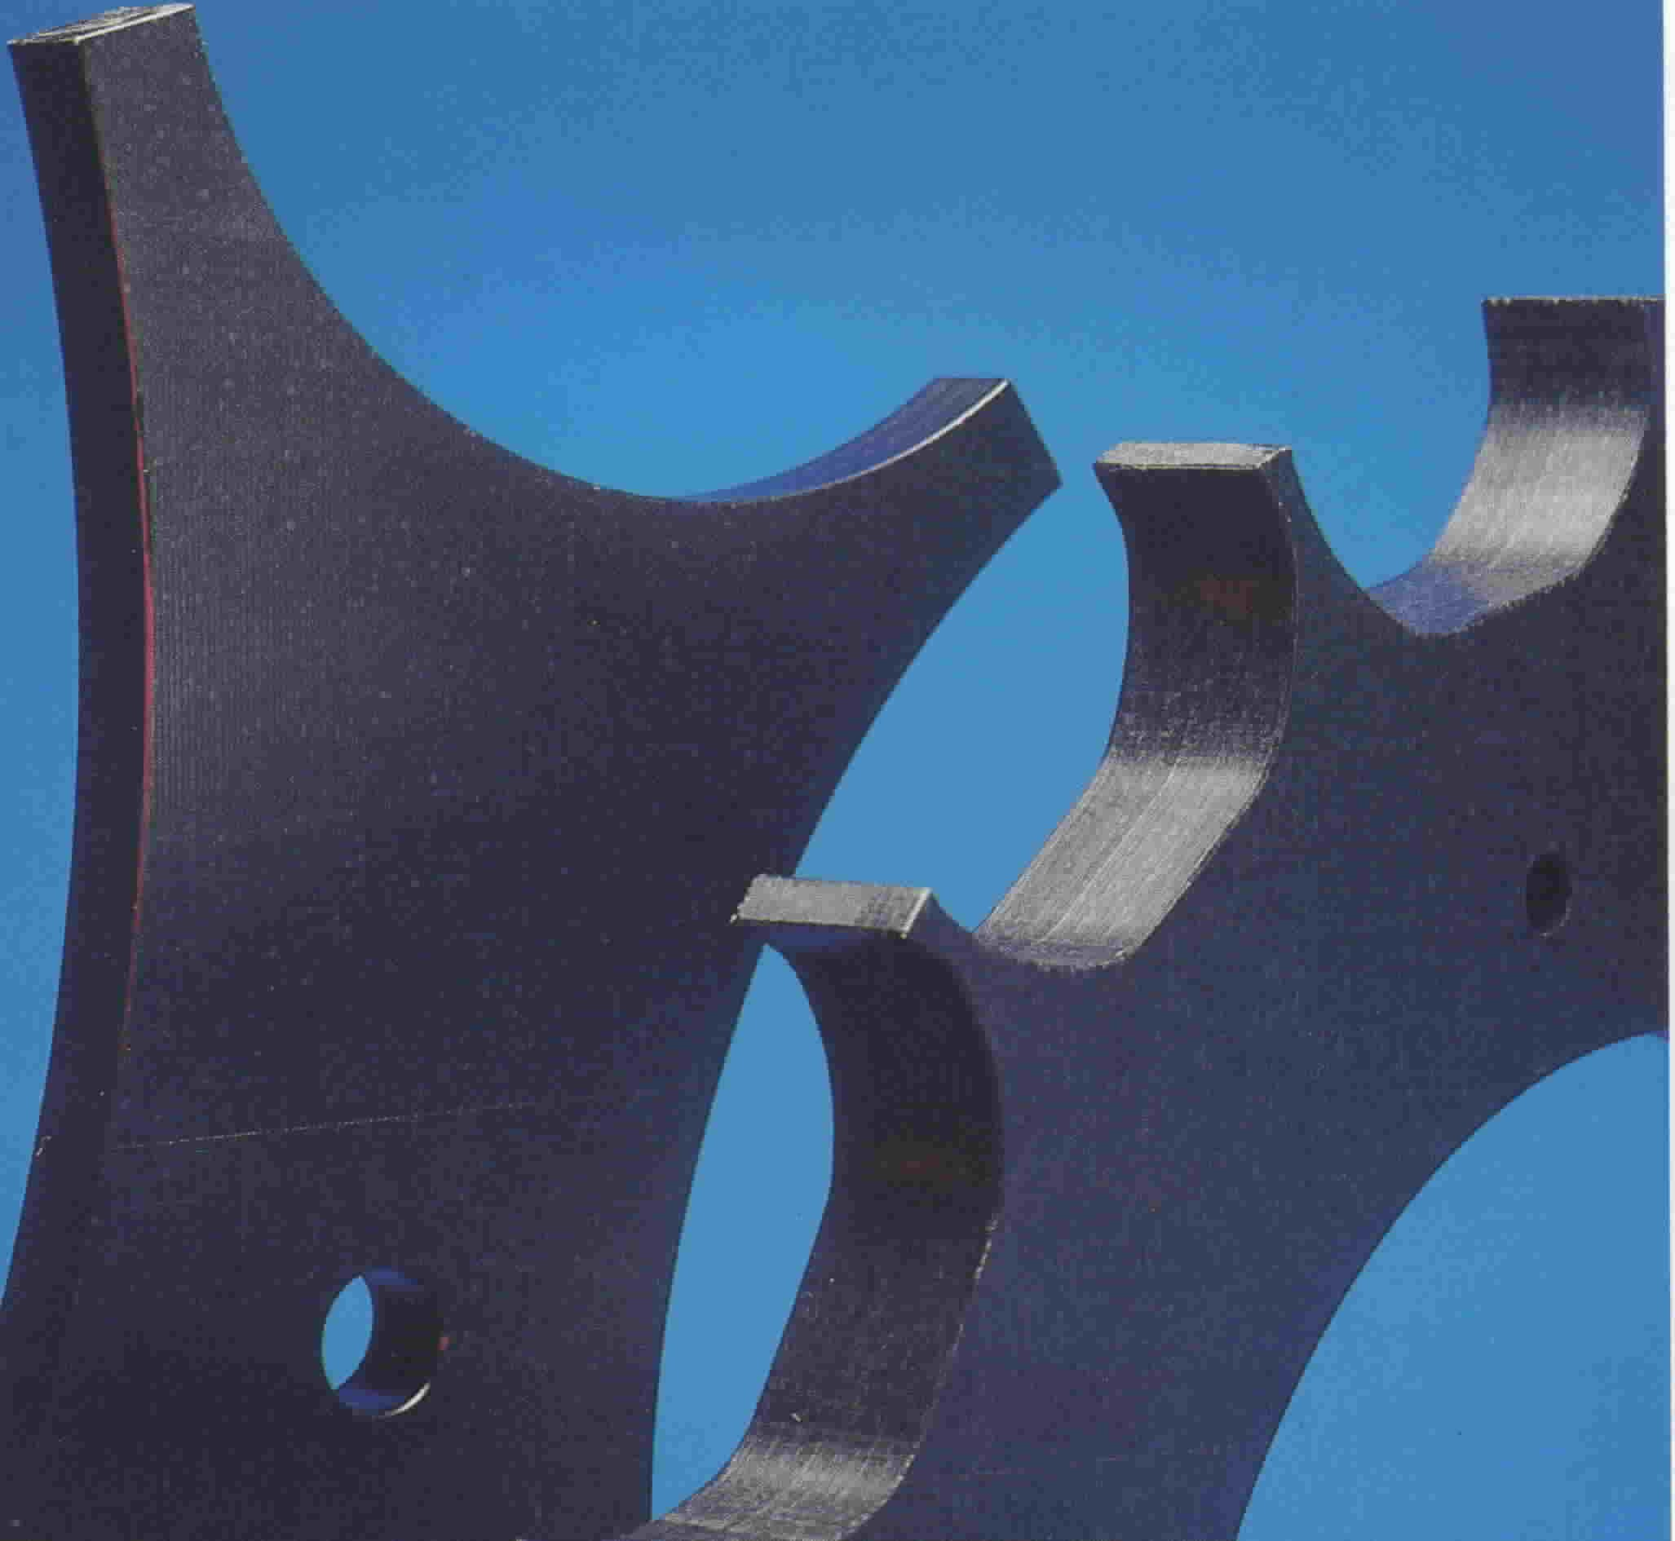
Ultra-high-molecular-weight polyethylene (UHMWPE)
Chain Length: 2-6 million
Joint Replacement
Helmet
Gears

Slide 18
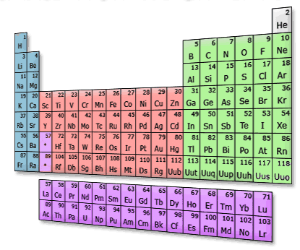
Endless Possibilities
New Functional Groups
Different Polymer Backbones

Slide 19
Functional Groups

Slide 20
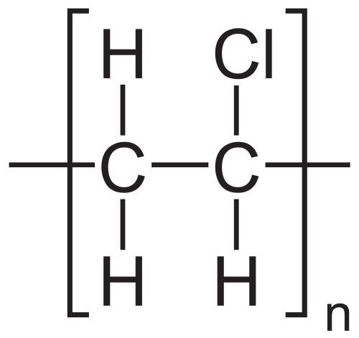
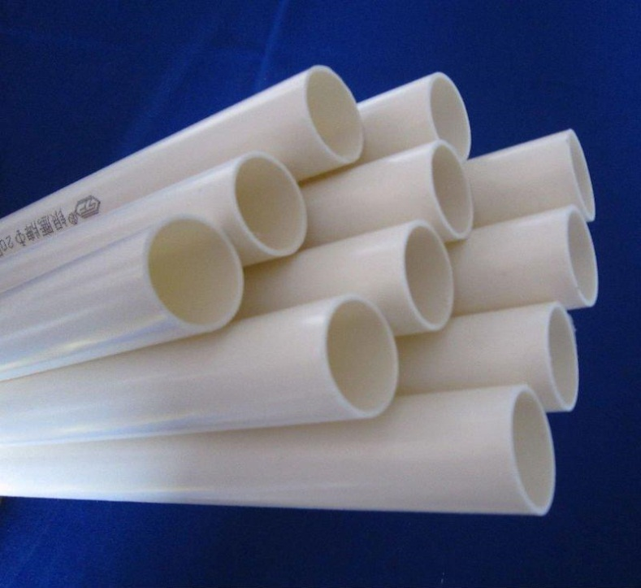
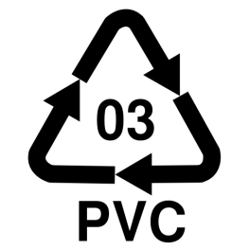
PVC – (polyvinyl chloride)
Chain Length: 4,000 – 5,000
More Polar → Stronger Bonding

Slide 21
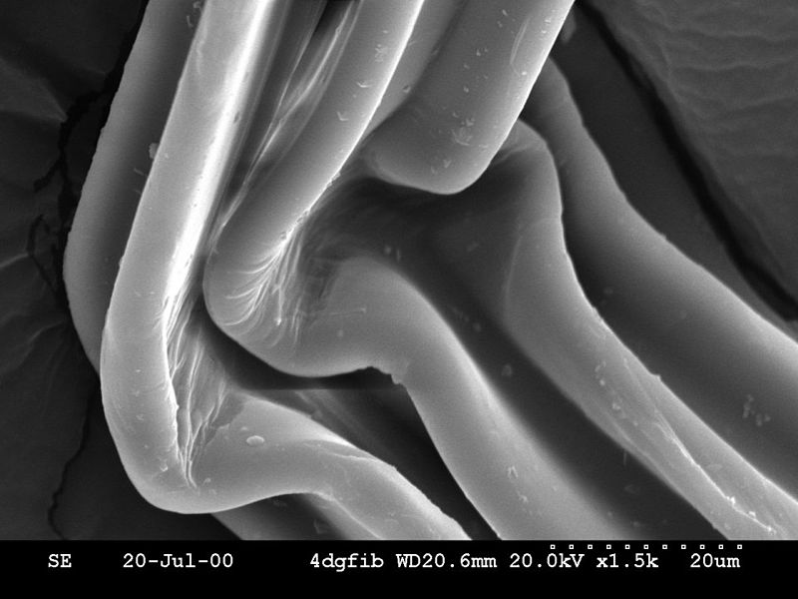
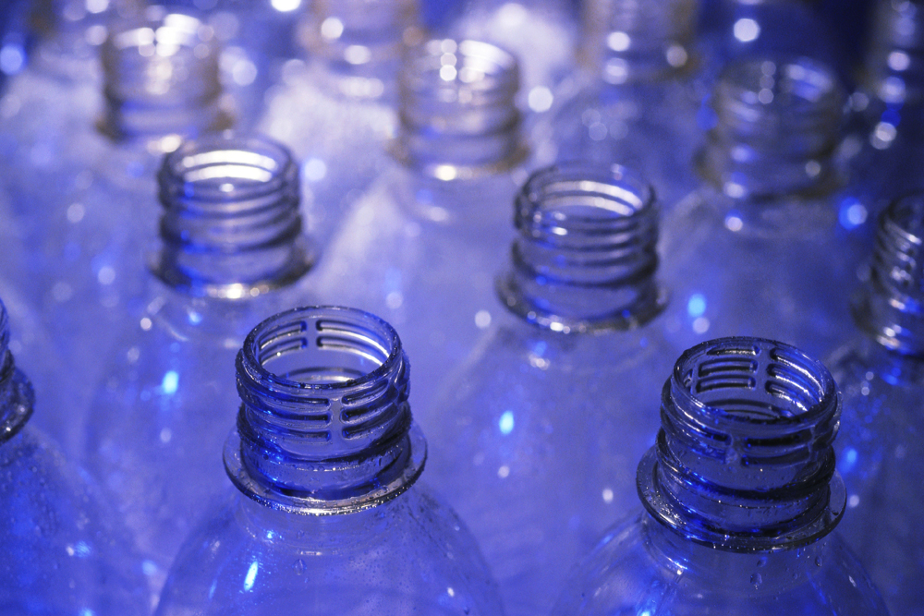
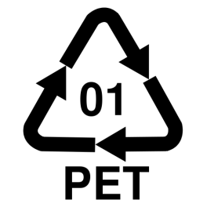
Polyethylene Terephthalate (PETE) “Polyester”
Chain Length: 4,000 – 8,000
Ester

Slide 22
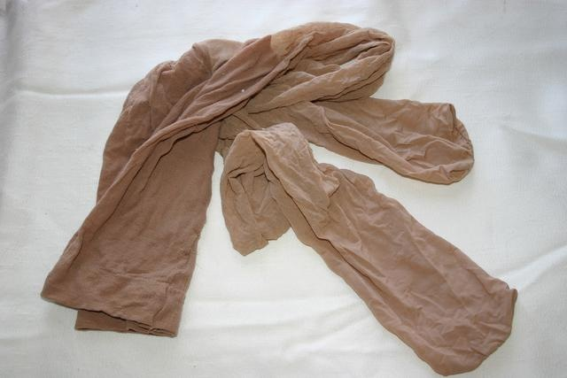
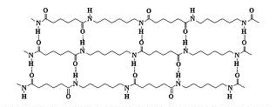
Nylon

Slide 23
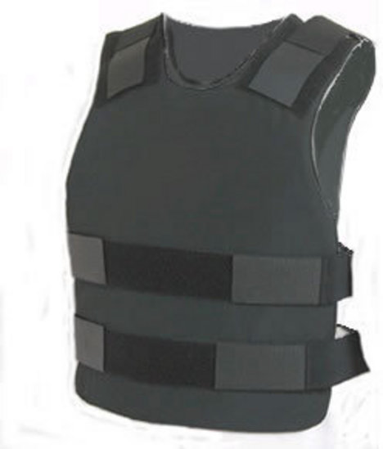
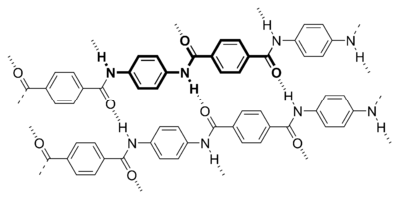
Kevlar
Strong Network of Covalent Bonds
And Polar Hydrogen Bonds

Slide 24
Endless Possibilities
New Functional Groups
Different Polymer Backbones

Slide 25
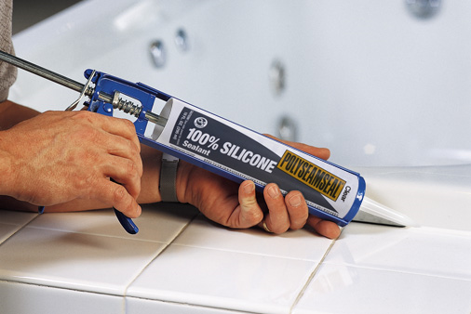
Inorganic Polymers
Silicon (Si)

Slide 26
Inorganic Polymers
Silicon (Si)
Germanium (Ge)

Slide 27
Inorganic Polymers
Silicon (Si)
Germanium (Ge)
Boron-Nitrogen (B – N)

Slide 28
Inorganic Polymers
Silicon (Si)
Germanium (Ge)
Boron-Nitrogen (B – N)
Aluminum – Nitrogen (Al – N)
…
…
On and on

Slide 29
Conclusions:
Polymers make up all sorts of materials that are all around us!
They can have a huge range or material properties based on their:
Functional Groups
Structure
Backbone
Keep thinking about how chemical interactions on the nano-scale correspond to material properties on the macro-scale

